Slide 1


Contrastive Retrieval Augmented In-Context Learning for Medical Classification Tasks with Imbalanced Data
Swarnika Joshi
Kshitij S Jadhav
Scottish High International School
Gurgaon, India
Koita Center of Digital Health
IIT Bombay, India

Slide 2


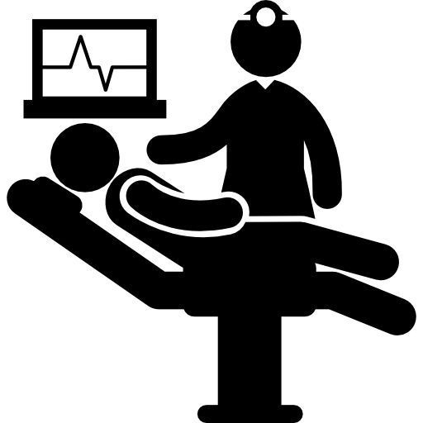


Classification Tasks in Medical Domain
No Diabetes
Diabetes
Disease
Detection
Cancer Patient
Roughly 13% of Patient
Roughly 18% of adult population
We usually have very small amount of
data in medical domain
Several classification problems in medical
domain have imbalanced data

Slide 3




Large Language Models as Classifiers
Text In
Text Out
You are given a set of clinical features…
Your task is to classify the patient…
Into one of the two classes….
(1) Side Effect (2) No Side Effect
Use the following template for output:
Class: Side effect
Confidence….
Class: Side Effect
Confidence: …
Clinical Features
Instructions

Slide 4
In-Context Learning of LLMs
Input 1
Output 1
Input 2
Output 2
Instruction
Test Input
Test Output
Test Input
Few Shot Examples in Input Prompt Leads to Better Accuracies

Slide 5
Which few shot examples should we use?
Examples that are similar to test input are more helpful
Retrieve similar examples for test input each time – Retrieval Augmented
Examples
Retrieval Augmented
In-Context Learning - RAIL
Nearest Neighbor
Search
Input 1
Output 1
Instruction
Test Input
Test Output
Input 2
Output 2

Slide 6
Problem with RAIL in case of imbalanced data
For each test input – Retrieve similar examples
Few shot examples are dominated by the majority class
  Not even a single example from the minority class

Slide 7
Contrastive Retrieval Augmented In-Context Learning : C-RAIL
Positive
Examples
Negative
Examples
Class-wise Nearest Neighbor Search
Input 1
Output 1
Input 2
Output 2
Instruction
Test Input
Test Output
Input n
Output n

Slide 8


Example Run for C-RAIL
BP: 82
Glucose: 122
TLC: 1.30
BP: 83
Glucose: 125
TLC: 1.28
BP: 83
Glucose: 120
TLC: 1.60
BP: 84
Glucose: 130
TLC: 1.46
BP: 84
Glucose: 125
TLC: 1.63
Class-wise
K-Nearest Neighbors
LLM

Slide 9
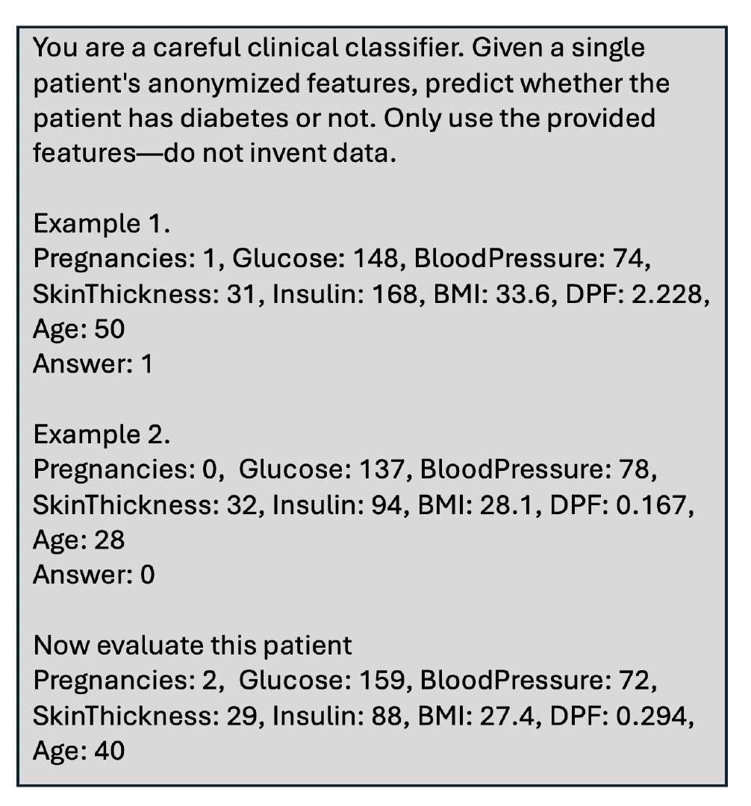
Example Prompt for C-RAIL
2-shot example prompt for C-RAIL

Slide 10
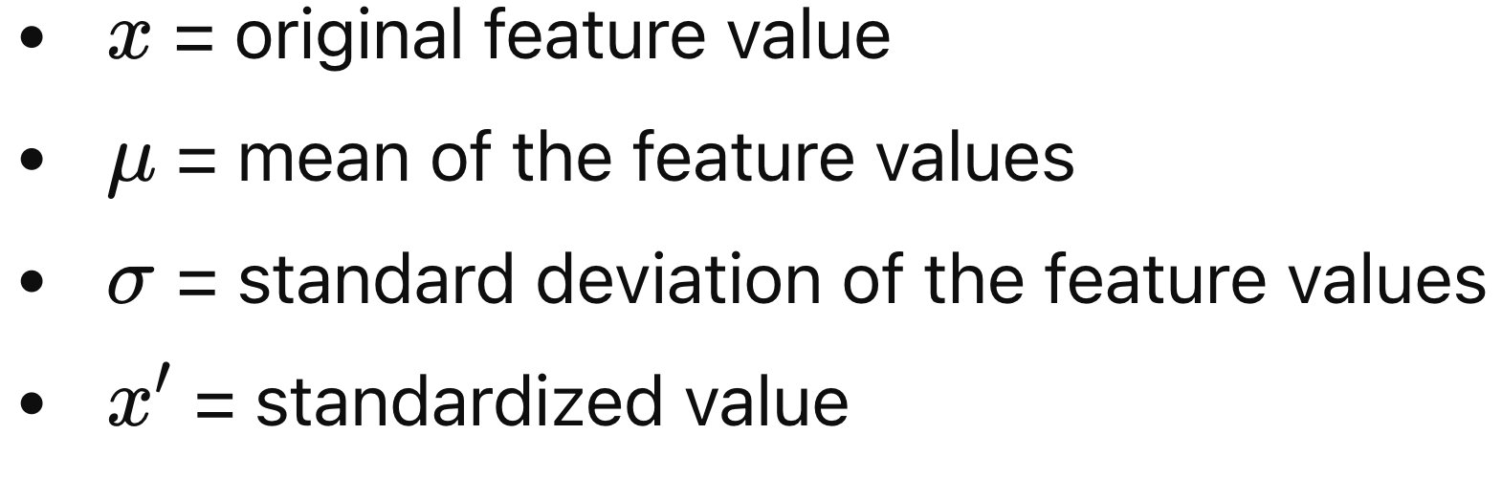
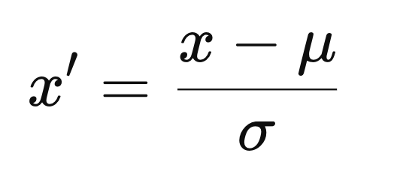
How to find similar examples : K Nearest Neighbor
Each input is represented as a feature vector
Glucose
BP
BMI
Age
Pregnancy
Insulin
DPF
148
72
33.6
54
4
94
0.62
Feature Standardization
Glucose
BP
BMI
Age
Pregnancy
Insulin
DPF
1.2
-0.8
1.4
1.1
1.1
-0.6
0.7
Use Euclidean distance as measure of dissimilarity

Slide 11
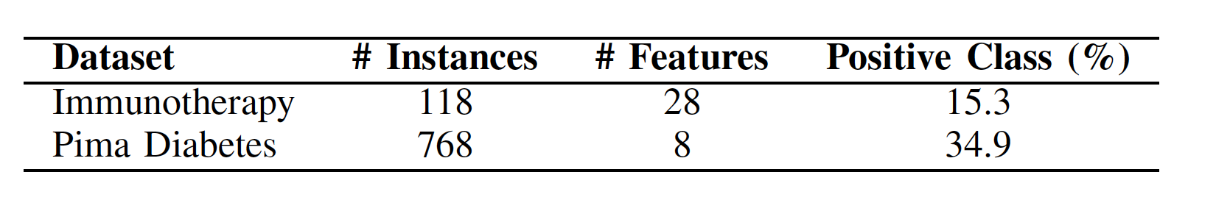
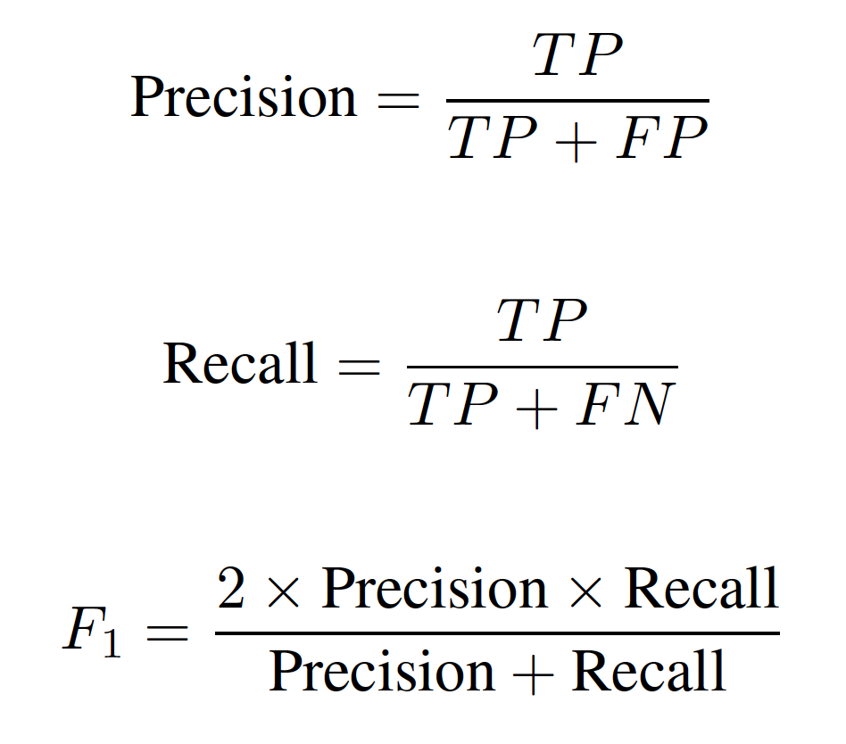
Experimental Evaluation
Datasets
Evaluation Metric
For both datasets positive class is important
  Side effect from immunotherapy
  Diabetes onset

Slide 12
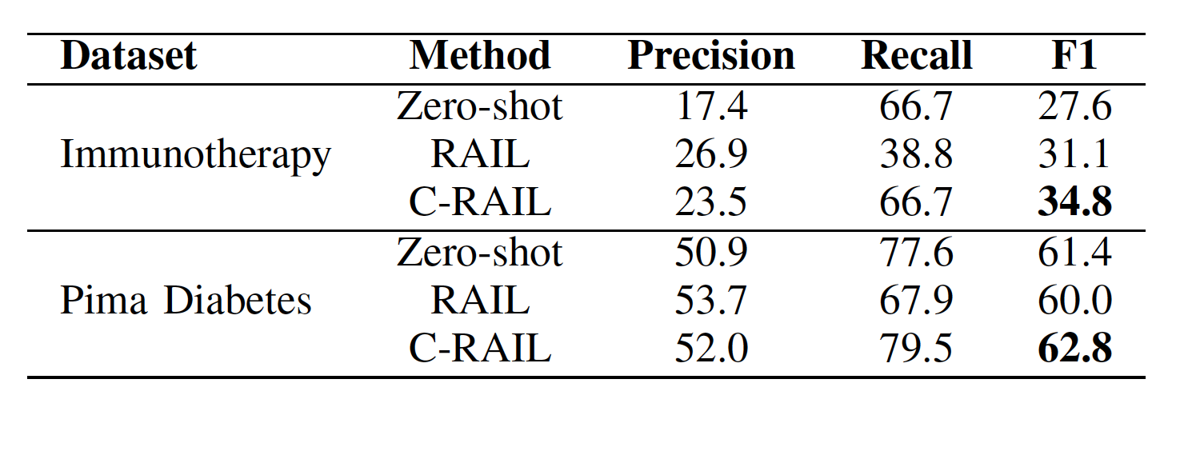
Experimental Set up and Results
Setup Details:
  Llama 3.1 8B model
  Greedy decoding
  Few shots : K = 6
RAIL
  improves precision
  Degrades Recall
C-RAIL : Best F1
  Improves precision
  Without degrading recall

Slide 13
Conclusions and Future Work
We proposed C-RAIL – an in-context Learning approach to select similar examples from all the classes in a balanced manner for a given example
Our results show that the proposed approach improves the recall numbers and F1 number in case of imbalanced datasets
In future work we plan to experiment with embedding based approaches to determine similar examples

